Slide 1
HR FLOW CHART

Slide 2
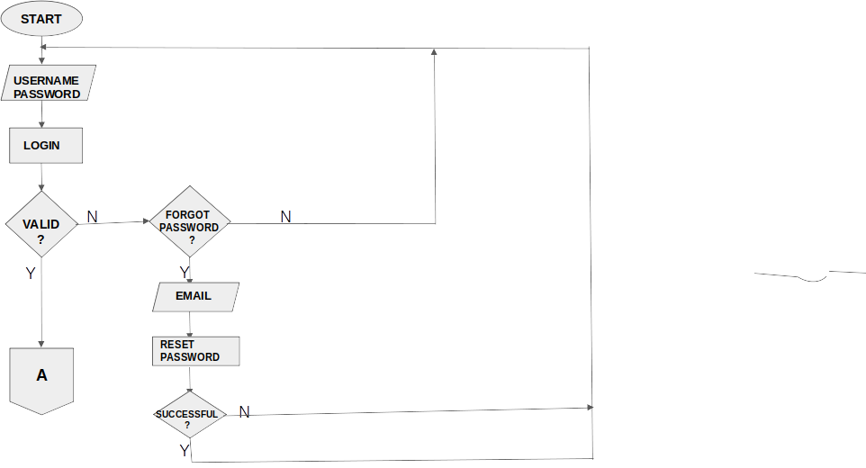
OPERATION

Slide 3
ADD
EMPLOYEES
?
A
N
B
A
Y
ADD AN
EMPLOYEE
?
N
i
Y
PERSONAL
DETAILS
?
N
Y
1
2

Slide 4
1
2
EMPLOYEE NAME,GENDER,DATE OF BIRTH,RESIDENTIAL STATUS,NATIONAL ID NUMBER,PIN NO,NHIF NO,PASSPORT PHOTO
N
SALARY DETAILS
?
Y
y
3
4

Slide 5
x
3
4
EMPLOYMENT TYPE,PAYMENT CURRENCY,MONTHLY SALARY,WORKSHIFT,DAILY HOURS,DAILY RATE,INCOME TAX,SALARY PROCESSING OPTIONS.
N
HR DETAILS
?
Y
y
5
6

Slide 6
x
5
6
JOB NUMBER,DATE OF EMPLOYMENT,CURRENT CONTRACT,CONTRACT START DATE AND END DATE,DURATION,JOB TITLE,REPORT TO,DEPARTMENT,
N
CONTACT DETAILS
?
Y
y
7
8

Slide 7
x
7
8
PERSONAL EMAIL,OFFICIAL EMAIL,ADDRESS,MOBILE PHONE NO.,OFFICE PHONE NO,CITY/TOWN,COUNTRY/PROVINCE/STATE,NEXT OF KIN
VALIDATE
y
9
10

Slide 8
x
9
10
N
IF=1
?
Y
SAVE
C

Slide 9
IMPORT
EMPLOYEES
?
B
N
D
A
Y
IMPORT

Slide 10
SAVE
C

Slide 11
VIEW
EMPLOYEES
?
N
D
E
Y
SEARCH
PARAMETER
QUERY
DATA
EMPLOYEE
PROFILE
C

Slide 12
LEAVE
APPLICATION
?
N
G
F
Y
APPLY FOR
LEAVE
?
N
Y
EMPLOYEE
TYPE OF LEAVE
DURATION
LEAVE BALANCE
VIEW LEAVE APPLICATION
?
N
21
22
y

Slide 13
x
21
22
APPLICATION DATE
LEAVE TYPE
DATE
LEAVE BALANCE
UPDATE
LEAVE
APPLICATION
?
N
LEAVE TYPE
LEAVE BALANCE
y
24
23

Slide 14
x
23
24
APPROVE
?
N
DECLINE
?
N
Y
APPLICATIONS
VALIDATE
y
27
25
26

Slide 15
X
26
27
25
N
IF=I
?
Y
C

Slide 16
LEAVE
CATEGORY
?
N
H
G
Y
ADD
LEAVE
CATEGORY
?
N
UPDATE
CATEGORY
?
N
PRINT
CATEGORY
Y
Y
Y
LEAVE CODE
LEAVE TITLE
DAYS ACCRUED
LEAVE TITLE
LEAVE
CATEGORY
LEAVE
CATEGORY
UPDATE
CATEGORY
MANAGE
LEAVE CATECORY
C

Slide 17
LEAVE
REPORTS
?
N
J
I
Y
VIEW
LEAVE
REPORT
?
N
PRINT
?
N
Y
LEAVE TYPE
LEAVE BALANCE
LEAVE DATES
REPORTS
SEARCH
VIEW
LEAVE REPORT
C

Slide 18
J
E
CHANGE
PASSWORD
?
N
Y
OLD PASSWORD
NEWPASSWORD
REPEAT PASSWORD
CHANGE
PASSWORD
N
SUCCESSFUL
Y
LOGOUT
C

Slide 19
